Slide 1
Background
Project intros
Current state of the project
Goal
Problem articulation
Has your idea been done by others?
Dataset(s)
Basic EDA’s
Database set up
Methods
What methods are you planning to use?
Any related literature to support your proposed methods?
References
Project Proposal:
Understanding Effects of Population Density and Mobility on COVID-19 Infection with Deep Learning Feature Extraction
Team Members:
Levi Davis, Matt Manner,
Tyler Valentine, Royal Wang
Supervisor:
Prof. Judy Fox

Slide 2
A Checklist of Goals (General)
Establish data and prepare it to meet the computational requirements of our models.
Aggregate mobility and rurality data to be included with the established data set from previous work.
Develop and test Temporal Fusion Transformer (TFT) deep learning models using UVA’s Rivanna HPC to understand the sensitivity of population density and mobility in the transmission of COVID-19.
Produce a 6-page publishable paper (in IEEE format), along with an oral presentation, on our work summarizing our research and findings.
Package and share our data, code, and reports on our GitHub repository.

Slide 3
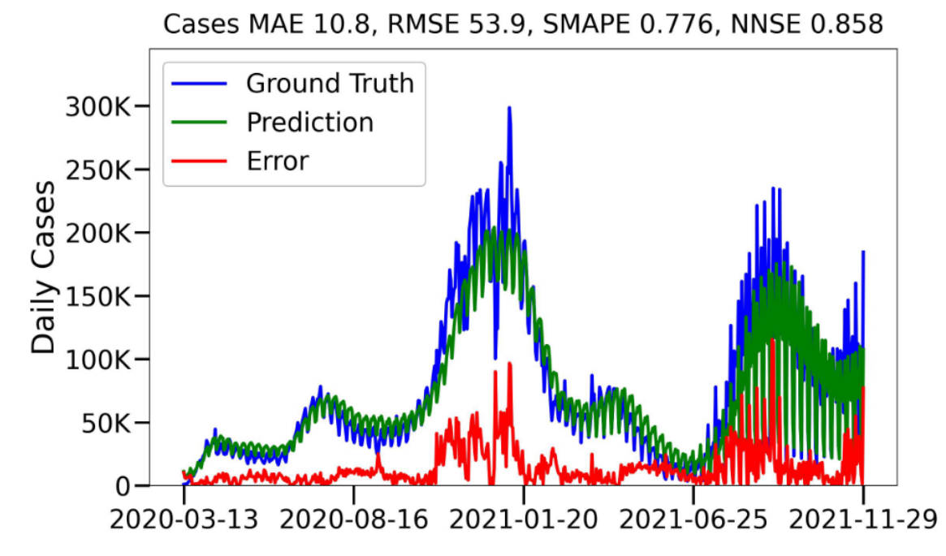
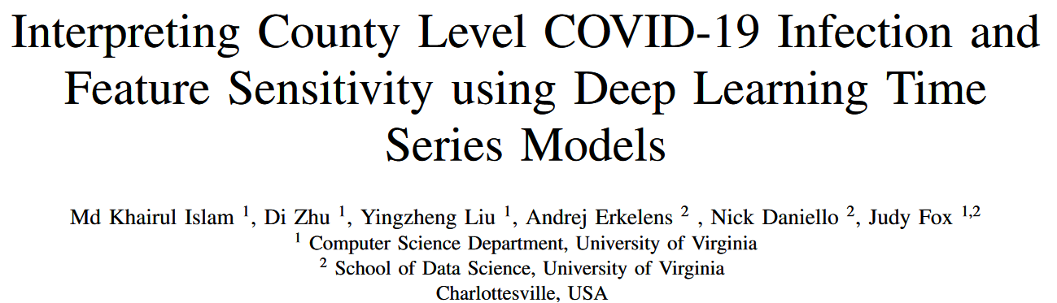
Background
Some studies of the transmission of COVID-19 emphasize accurate forecasting of future infection rates, which provides critical information to both the health system and policy makers. These models can identify features that affect disease spread across various regions and populations but lack sufficient interpretability to understand the model’s decisions.¹ Understanding model sensitivity to population covariates reveals which individuals have a higher risk of infection. Current literature explores the sensitivity of vaccination by distribution of age and occupation in U.S. counties.² ³ We seek to build upon these results by obtaining insight into the effect of population density and mobility.

Slide 4
Goals (Specific)
Problem articulation
We want to better understand the sensitivity of population density and mobility in the transmission of COVID-19. This understanding may be useful for determining which populations were most affected by COVID-19.
Has your idea been done by others?
To our knowledge, no prior studies have applied deep learning feature extraction to understand the effects of population density and mobility on COVID-19 transmission. However, there are numerous studies that use various mathematical models to forecast infection rates based on individual travel data obtained from mobile devices. We intend for our work to expand upon this understanding of how geographic location and movement impacted transmission of COVID-19 near the beginning of the pandemic.
Problem articulation
Has your idea been done by others?

Slide 5
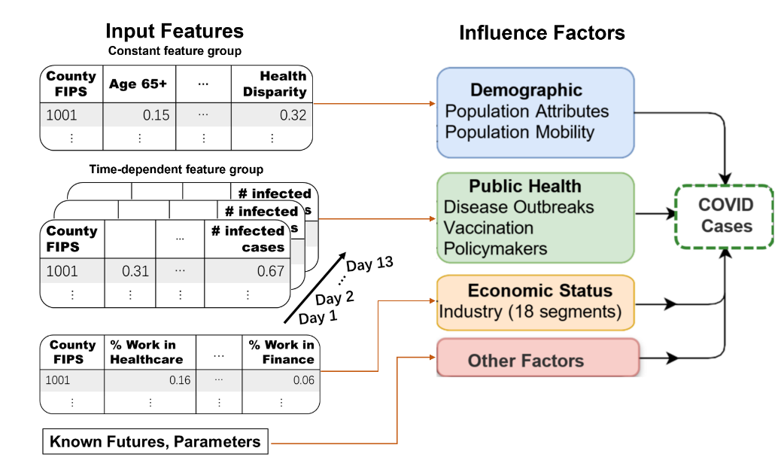
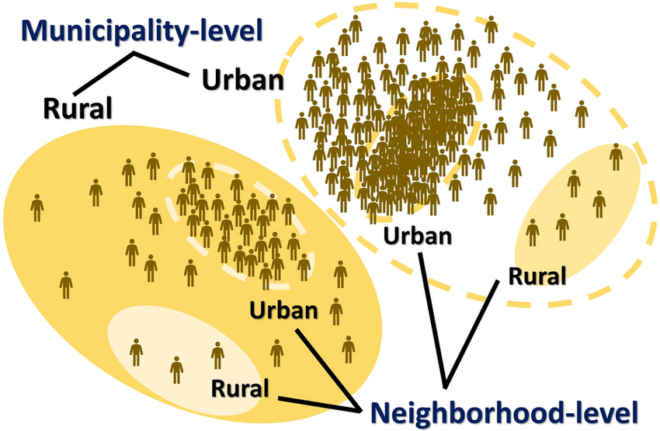
Data sets
The data set from previous study includes 2 static variables and 4 dynamic variables. However, we intend to add mobility data (from the Bureau of Transportation Statistics) and rurality data (from the U.S. Census Bureau).

Slide 6
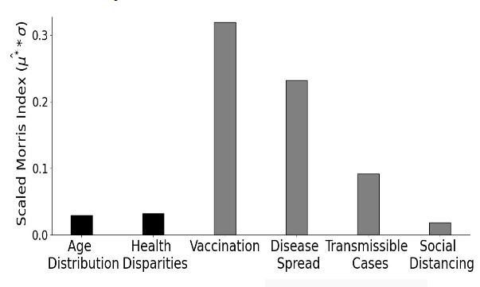
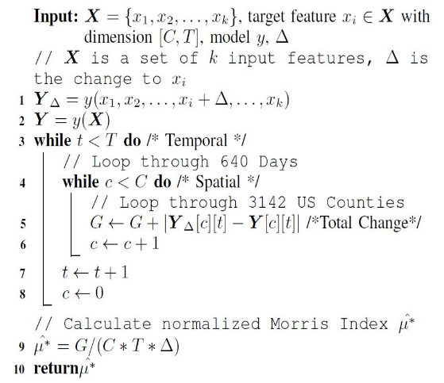
Methods
What methods are you planning to use?
We plan to train a Temporal Fusion Transformer (TFT) deep learning model and apply the Morris method to see how sensitive the predictions are to changes to the input features.
Any related literature to support your proposed methods?
A recent study involves using this method to understand the sensitivity a TFT model to six features. We plan to understand these methods to apply them to our own study with an additional two variables.

Slide 7
Moving Forward
0900-1100 Monday meeting
Weekly/biweekly huddle for vector check
Continuing literature review
DS6050: Deep Learning class for DL/NN fundamentals

Slide 8
Conclusions & Future Work (TBD)
What solutions you have accomplished and how do they compare with related work?
Any insights or observations from this work?
What can be done in future work?

Slide 9
References
S. Ghafouri-Fard, H. Mohammad-Rahimi, P. Motie, M. A. S. Minabi, M. Taheri, and S. Nateghinia, “Application of machine learning in the prediction of COVID-19 daily new cases: A scoping review,” Heliyon, vol. 7, no. 10, p. e08143, Oct. 2021, doi: 10.1016/j.heliyon.2021.e08143.
M.-G. Hâncean et al., “Occupations and their impact on the spreading of COVID-19 in urban communities,” Sci Rep, vol. 12, no. 1, p. 14115, Aug. 2022, doi: 10.1038/s41598-022-18392-5.
M. K. Islam, D. Zhu, Y. Liu, A. Erkelens, N. Daniello, and J. Fox, “Interpreting County Level COVID-19 Infection and Feature Sensitivity using Deep Learning Time Series Models.” arXiv, Oct. 06, 2022. doi: 10.48550/arXiv.2210.03258.

